Slide 1
WHAT HAPPENED ????????
EPHESIANS 4:4-5, 1:22-23
MATHEWS 24:3-5, 11, 24-25
2 THESSALONIANS 2:9-12

Slide 2
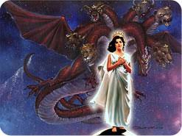
CHRIST, THE WOMAN AND THE DRAGON REVELATION CHAPTER 12-13

Slide 3
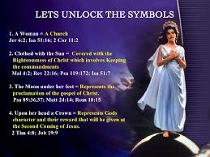

Slide 4
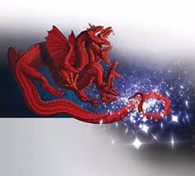
A THIRD OF HEAVENLY ANGELS (STARS) WERE DECEIVED (REV. 12:7-9

Slide 5
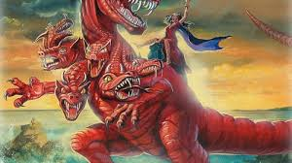
THE DRAGON IS THE DEVIL REV. 12:7,8, 9,11-17

Slide 6
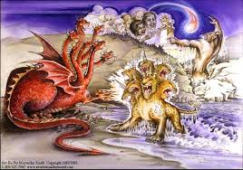
THE DEVIL DECEIVES THE WHOLE WORLD (REV. 13:1)

Slide 7
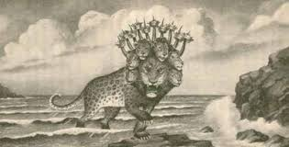
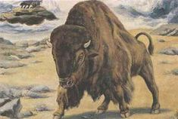
SATAN DECEIVES THE WHOLE EARTH REV. 13:2-4

Slide 8
THE LAMBLIKE BEAST FROM THE EARTH REV. 13:11

Slide 9
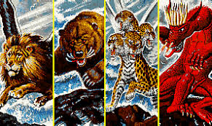
DANIEL 7:17

Slide 10
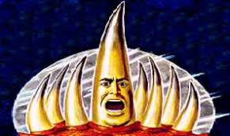
BEGINNING ANOTHER CHURCH DANIEL 7:25

Slide 11
THE WHOLE WORLD WORSHIP THE BEAST (REV. 13:2-4,8).

Slide 12
WARNING REVELATION 13 :8; 14:9

Slide 13
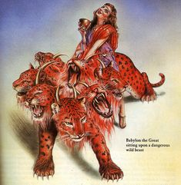
REV.17: THE CHURCH AND WORLD POLITICS

